Slide 1
Unix tutorial
Introduction to Unix
cs4402

Slide 2
Unix tutorial
Outline
Basic background in Unix structure and its History
Directories and files I (listing, navigation, filenames)
Directories and files II (working with files & their content)
Redirection (output, input, pipes)
Editors
Access rights, processes
Other useful Unix commands

Slide 3
Unix History
Unix has a rich history dating back to the development of Multics and then Unic system. First developed at AT&T Bell labs in the early 70's. These early forms have dispersed and integrated into computing, include the Ubuntu, Debian Linux Variants variants we use here and the MacOS, BSD variants. Unix is even run on the mobile platforms, both iOS and Android are based on Unix system architecture.
The Unix Components
The Unix-Computer ecosystem can be divided into three main parts
User Space
Defines the applications, libraries, and standard utilities that are user accessible.
Kernel Space
This refers to the operations of OS that manage the interface between user actions and the hardware. It is the central part of the OS, and its primary job is to pair user applications with the underlying hardware and allow multiple programs to share singular hardware components. For example, how does a user input event, such as typing 'a' on the keyboard, get translated into 'a' appearing on the screen? Or, how does two programs both read from disc at the same time or run on the CPU at the same time?
Hardware
The underlying physical components of the computer. These include Input/Output devices, like keyboards and monitors, the CPU which does calculations, the memory components, and the network interface.

Slide 4
Linux.
Linux was developed in 1991 by Linus Torvalds
Torvalds modeled Linux after Minix, an educational OS by Tanenbaum, based on the POSIX standard.
Torvalds continues to lead development of the Linux kernel; because it is open source, anyone is free to incoroporate the Linux kernel into an OS distribution, and many different 'flavors' of Linux exist.
Linux emphasizes speed and performance, but evolved away from the microkernel design of Minix.
Linux is considered more of a monolithic kernel design.
It adheres mostly to the POSIX standard
Linux is important as the first fully-featured, completely open-source OS.

Slide 5
Unix - basic background (oversimplified)
UNIX is a common operating system (suite of programs which make the computer work) made up of three parts; the kernel, the shell and the programs.
The kernel
The kernel of UNIX is the hub of the operating system: it allocates time and memory to programs and handles the filestore and communications in response to system calls(create process (for example, fork on Unix-like systems, create file, delete file, get/set time or date)
The shell
The shell acts as an interface between the user and the kernel.
When a user logs in, the login program checks the username and password, and then starts another program called the shell. The shell is a command line interpreter (CLI).
The commands are themselves programs: when they terminate, the shell gives the user another prompt (~> on our systems).

Slide 6
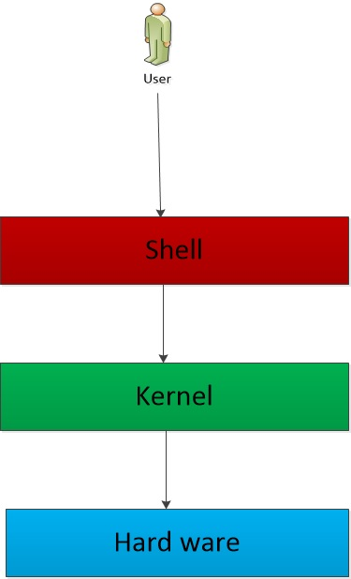

Slide 7
Primary Components of Operating System
The OS'es primary task is to manage services as an interface between the user and the hardware. Examples include:
File System: managing files on the user
Device I/O: managing input from devices
Processes: Starting, running, and stopping programs, and allowing multiple programs to run at once, i.e., program multiplexing
Memory Management: Allocating runtime memory for process and separating memory between process and between user-space and the kernel-space
From a user of the OS, you will see these interactions from two perspectives
Shell use the shell to interact with the OS
System Call API program in C to interact with the OS

Slide 8
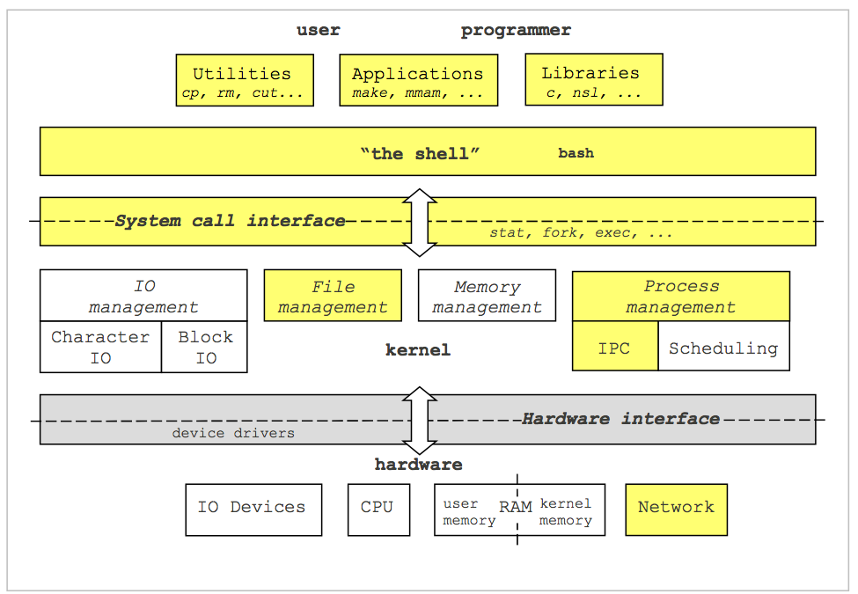
Unix Archietecture

Slide 9
Unix - basic background (oversimplified)
Filename Completion
By typing part of the name of a command, filename or directory and pressing the
[Tab] key, the shell will complete the rest of the name automatically.
If the shell finds more than one name beginning with those letters you have typed, it will beep, prompting you to type a few more letters before pressing the tab key again.
History
The shell keeps a list of the commands you have typed in. If you need to repeat a command, use the cursor keys (arrows) to scroll up and down the list or type "history" for a list of previous commands.

Slide 10
Unix - basic background (oversimplified)
Files and processes
"Everything in UNIX is either a file or a process."
A process is an executing program identified by a unique PID (process identifier).
In computing, the process identifier (normally referred to as the process ID or just PID) is a number used by most operating system kernels to uniquely identify an active process.
A file is a collection of data. They are created by users using text editors, running compilers etc. It is identified by a name and an logical address (or path).
Examples of files:
a document (report, essay etc.)
the text of a program written in some high-level programming language
instructions comprehensible directly to the machine and incomprehensible to a casual user, for example, a collection of binary digits (an executable or binary file)
etc…

Slide 11
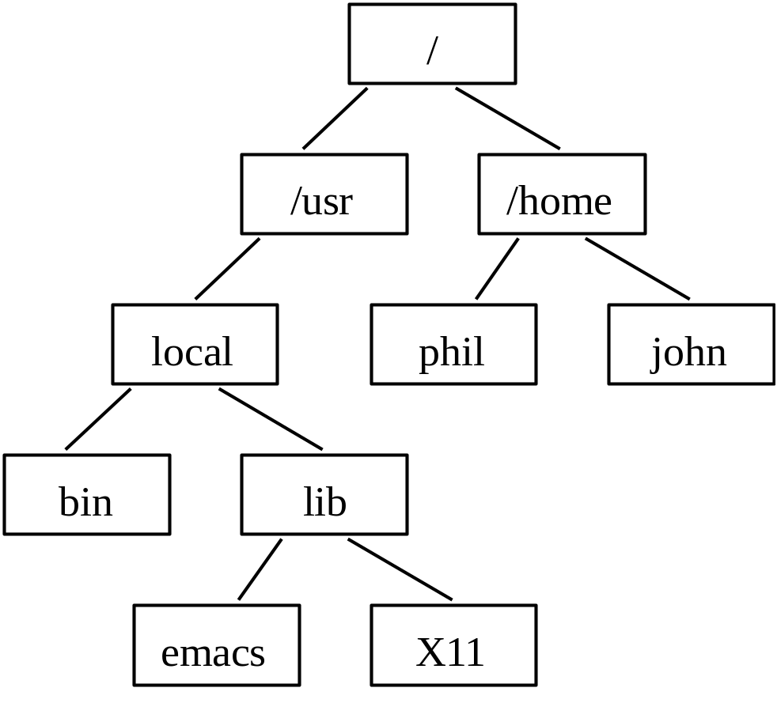


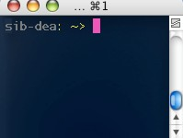
Unix - basic background (oversimplified)
The directory structure
Starting an terminal session (CLI)
1)
2) An terminal window will appear with a Unix prompt, waiting for you to start entering commands.

Slide 12
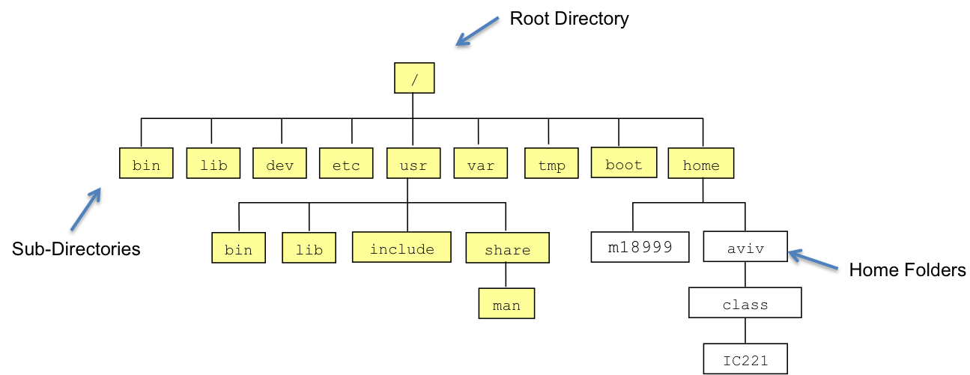
The UNIX File System

Slide 13
The Key Components of UNIX File System
The base UNIX file systems always has the same basic structure:
/: The root of the file system. All files and directories fall under this.
/usr: Stands for Unix System Resources. Contains system utilities.
/sbin: System binaries. Contains essential system administration programs that are generally run by the superuser (Administrator).
/opt: Optional software. Third party software is usually installed here. It's kind of like the "Program Files" directory in Windows.
/etc: System configuration files. This is where things like the password file, and global system configuration files live.
/home: Contains the user home directories.
/tmp: Temporary files. When the system reboots, these go away.
/kernel: The core operating system. Like the "Windows" folder in Windows.
/usr/lib: Contains precompiled libraries for use by everyone on the system. This is a little bit like the folder containing all of the .DLL files in Windows.
Any directory that ends in bin: Contains binary executable files or links to them.

Slide 14
Unix - Directories and files I
ls
lists files in a directory
/
ls -la
lists all (a) files in long (l) format
/usr
/home
mkdir
creates a new subdirectory
local
phil
john
bin
lib
file.txt
dir_1
rmdir
removes an EMPTY directory
file2.txt
file3.txt
pwd print working directory (path, current location)
(/home/john)
cd
changes current directory
Note: typing cd with no argument or typing cd ~
always returns you to your home directory.
.
. .
in UNIX means the current directory
in UNIX means the parent of the current directory

Slide 15
Here is a sample of using these commands to explore the file system
:
aviv@zee:~$ pwd
/home/scs/aviv
aviv@zee:~$ ls
aviv-local@ class/ Downloads/ local/ Public/ test.c VBox-Map/ #VM-notes.txt#
#.bashrc# Desktop/ ic221/ Music/ Templates/ test.c~ Videos/ VM-notes.txt
bin/ Documents/ id_rsa.pub Pictures/ test* tmp/ VirtualBox VMs/ VM-notes.txt~
aviv@zee:~$ cd tmp/
aviv@zee:~/tmp$ ls
aviv@zee:~/tmp$ cd ..
aviv@zee:~$ ls ~blenk
ls: cannot open directory /home/scs/blenk: Permission denied
aviv@zee:~$ ls class/ic221/
hw/ lab/ submit/
aviv@zee:~$ ls class/ic221/hw
hw1.pdf

Slide 16
Unix - Directories and files II
cp
copies files
copy orig.file copy.file (pathname may be required)
/
/usr
/home
mv
moves/renames a file
mv file1 file2
local
phil
john
bin
lib
file.txt
dir_1
rm
removes/deletes a file
rm -i file2 (-i : interactive)
file2.txt
file3.txt
clear
clears all text
find
searches the directory tree for a file
find . -name lostfile -print
*
matches any number of characters in a file (or directory) name
?
matches only one character.

Slide 17
Unix - Directories and files II
cat
concatenates/displays all the content of a file on the screen
less
displays the content of a file one screenful at a time
less file.txt
then press spacebar to display the next screen or use arrow keys to move up or down row by row.
(Type / followed by a word to find it in the file. Press Q to quit).
more
(see less)
head
prints the first lines of a file on the screen
(10 by default or specify the desired number of lines with "-")
head -20 file.txt diplays the first 20 lines from the file "file.txt"
tail
prints the last lines of a file on the screen
(10 by default or specify the desired number of lines with "-")
tail -20 file.txt diplays the last 20 lines from the file "file.txt"

Slide 18
Unix - Directories and files II
diff
compares two files and prints how they differ
diff file1 file2
wc
displays a count of lines, words and characters in a file (word count)
grep
searches a file for a string and displays all the lines containing this string
grep word file.txt
displays all lines containing "word"
grep "following words" file.txt displays all lines containing "following words"
grep -c word file.txt displays the number of lines containing the string
grep -e "one" -e "two" -e "three" file.txt displays all lines containing "one" or
"two" or "three"
grep -v "word"
displays all lines that do not contain "word"

Slide 19
Unix - Directories and files II
od
The od command copies sequentially each input file to standard output and transforms the input data according to the specified options.
od -c file.txt
displays some non-graphic characters as C-language escapes (see more options: man od)
null backspace form-feed new-line return
tab
\0
\b
\f
\n
\r
\t
Important:
Unix & all Unix flavors: \n
Mac OS : \r
Windows:\r\n

Slide 20
Unix - Editors
emacs
Emacs is the extensible, customizable, self-documenting real-time display editor. (http://www.gnu.org/software/emacs/emacs.html)
pico
A Unix text editor
(http://www.indiana.edu/~ucspubs/b103/)
vi
The Unix text editor
(http://www.unix-manuals.com/refs/vi-ref/vi-ref.htm) vim, gvim, etc…
Notes:
Assignment: discussion about Editors used in Unix such as emacs, pico, vi?

Slide 21
Unix - Access rights, processes
Each file (and directory) has associated access rights, which may be found by typing ls -l :
Owner of the file |  |  | Group owning the f |  | ile Date |  | of creation
sib-dea: ~> | ls | -l
total 4
drwxr-xr-x | 2 | student01 | dea | 512 | Feb | 16 | 17:30 | cgi-bin
-rw-r--r-- | 1 | student01 | dea | 0 | Feb | 18 | 01:39 | file.txt
drwxr-xr-x | 2 | student01 | dea | 512 | Feb | 16 | 17:30 | public_html
9 letters code indicating right access
Size
Name
d indicates a directory

Slide 22
Unix - Access rights, processes
Access rights on files.
r (or -), indicates the presence (or absence) of permission to read and copy the file
w (or -), indicates write permission (the permission to change a file)
x (or -), indicates execution permission (the permission to execute a file)
Access rights on directories.
r allows users to list files in the directory
w means that users may delete files from the directory or move files into it
x means the right to execute files in the directory.
owner |  |  | group |  |  | others
r | w | x | r | w | x | r | w | x

Slide 23
Unix - Access rights, processes
Changing access rights on files: chmod
u | USER
g | GROUP
o | OTHERS
r | READ
w | WRITE
x | EXECUTE
- | TAKE AWAY PERMISSION
+ | ADD PERMISSION
a | ALL
chmod a+x file.pl
chmod g+w file.pl
owner |  |  | group |  |  | others
r | w | x | r | w | x | r | w | x

Slide 24
Unix - Access rights, processes
ps
displays information about all processes with their associated PID and status, type
bg
moves the current process to the backround (can be done by adding & after the command)
fg
moves the current process to the foreground
jobs
lists backround and suspended processes
kill
stops a process (use ps or jobs to find the process id)
kill %1 (kills the job number 1)
ctrl-C
stops the current process

Slide 25
Other useful Unix commands
date displays current date and time
passwd to modify the users's password
creates (or extracts) a tarball from (to) a list of files
tar -cvf tarball.tar subdir/* tar -xvf tarball.tar
(the -z option compacts the files by gzip. when -z is used it is advised to
use the "gz" extension in addition to tar)
tar
logout
logs current user out
exit
logs current user out and closes the shell

Slide 26
The most useful Unix command
man The man command (short for "manual")
displays the manual page for the specified command at your terminal. To page through the output, press the Return key. To exit, type Ctrl-c.
man grep
(Lists help information on the "grep" command.)
If you don't know which command you want? Well …
An alternative is to use the "-k" option to tell man to do a keyword lookup for manual pages containing the keyword.
man -k route
(This command displays a one-line summary from each manual page matching the keyword "traceroute"
Look through the matches for a likely candidate manual page.)

